Slide 1
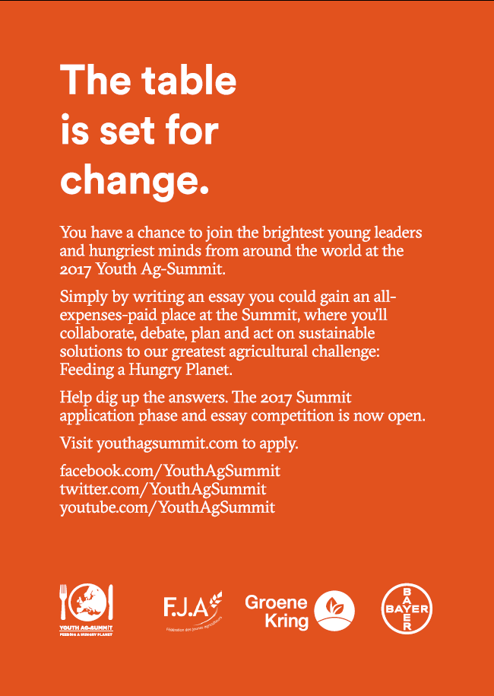

Slide 2
Every day the world’s population increases by 233,000 people. Add water shortages, a lack of arable land and increased agricultural pests, weeds and diseases – and we’ve got a global food supply that’s under incredible pressure.
By 2050, there will be 9 billion hungry people in the world and less farmland and resources than there’s ever been. The solutions are keenly debated both in rural and urban society. We believe there is a need for young leaders to be engaged in finding sustainable agricultural solutions to the growing global need for safe, nutritious food.
What’s your vision on how to feed a growing world population?
On October 9-13, 2017, young leaders from around the world will gather at the Global Youth Ag-Summit to discuss ideas, develop a vision and deliver action. If you’re 18-25 and care about our planet’s future, you should be part of this. Send us your thoughts and we might send you to Brussels, Belgium, to share them with 100 other bright young minds and leaders.

Slide 3
Essay question
In the next 40 years, it is projected that the world population will grow from 7 to almost 10 billion. However, 1 billion people today still do not have enough safe and nutritious food to eat. Demand is rising while resources are dwindling. Solutions are strongly debated across rural, urban and international communities.
In September 2015, the world’s leaders came together to agree on the United Nations Sustainable Development Goals (SDGs) to end poverty, protect the planet and ensure prosperity for all.
In the context of “Feeding a hungry planet” and using your own village, town, city or country as your point of reference, tell us on which SDGs youth can have the most impact in the next one to five years, both at a local and global level.
You should explain how working on these SDGs youth can bring real change to agricultural or food chain practices, or personal and community behaviors, that could help feed 10 billion and create a more sustainable local and global society.
www.youthagsummit.com

Slide 4
Essay Contest Overview
The essay must be complete via the online application tool which is accessible via www.youthagsummit.com
Essay length must not exceed 1500 words. No minimum word count.
It must be typed and written in English
Application close date: January 13, 2016 (11:59 GMT)
• Local selection phase: Mid January – March, 2017
Participants notification: April, 2017

Slide 5
Participant criteria
As of October 8, 2017, participants must be a legal adult in the participant’s home county (for which the participant holds a passport or permanent residency) and not younger than 18 or over 25 years of age.
• Legally able to travel internationally.
• Holding a valid passport, with at least six months validity after October 7, 2017.
• Proficient level of English/able to communicate orally in English
• Comfortable with cultural diversity
• Have strong leadership qualities
• Some public speaking skills would be an asset 6
• Have a demonstrated passion for agriculture, environmental stewardship, food, world hunger, biotechnology, and/or farming
• NOT an employee of a Bayer entity or direct family member
• NOT a previous delegate to the 2013 or 2015 YAS.

Slide 6
In case of questions your contact at Bayer:
Majsa Dezső
Bayer Hungária Kft.
dezso.majsa@bayer.com
+36209731623

Slide 7
